Slide 1
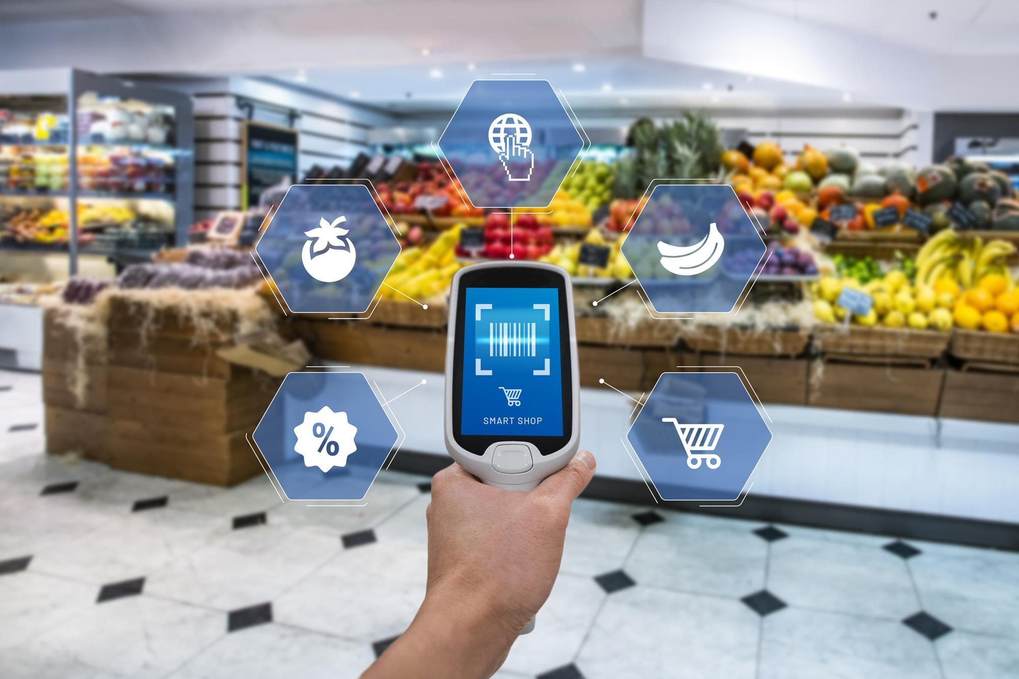
Smart Grocery Assistant with AR & AI
Enhancing Your Shopping Experience

Slide 2
What is AR & AI?
AR (Augmented Reality): Displays digital info over real-world objects.
AI (Artificial Intelligence): Learns user preferences, recommends products, predicts shopping patterns.
Combined: Helps users make smarter shopping decisions instantly.

Slide 3
Problem Statement
People often struggle to find products quickly or make healthy/efficient choices while shopping.
Traditional grocery shopping can be time-consuming and confusing.
Need: A smart assistant to simplify the experience.

Slide 4
How the Smart Grocery Assistant Works
Scan products using your phone.
AR shows price, nutritional info, reviews, or discounts.
AI suggests alternatives, recipes, or deals based on your preferences

Slide 5
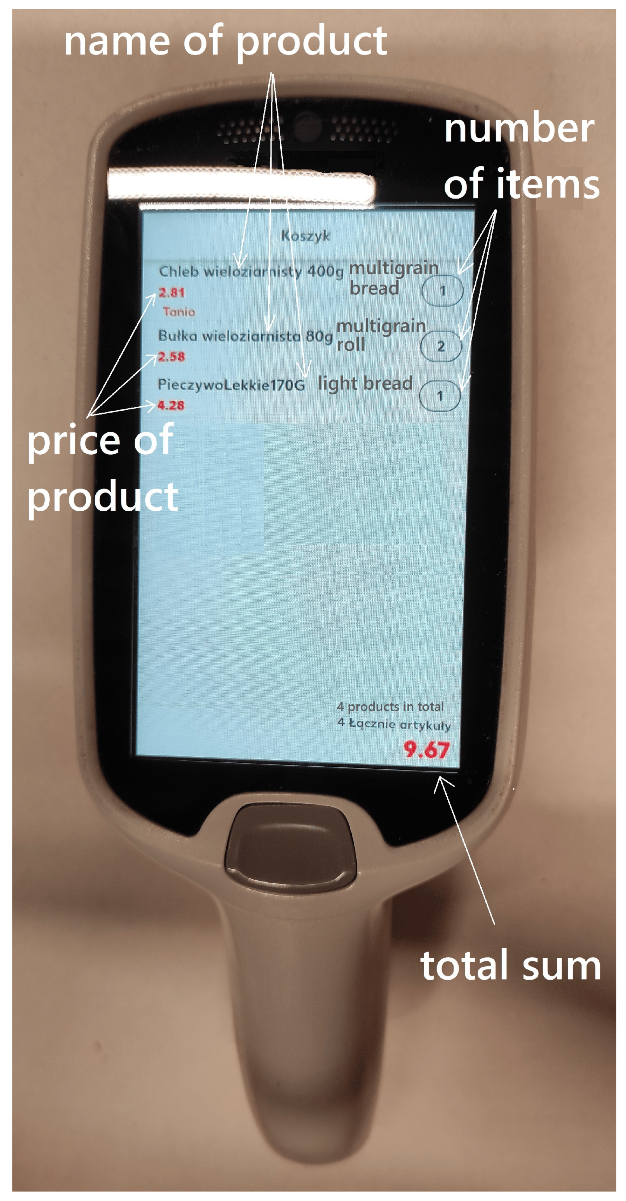
Key Features
Product Recognition: Identify items with camera.
Personalized Recommendations: AI suggests items based on history
Price Comparison: Compare prices across brands.
Shopping List Automation: AI creates lists for you.
AR Visualization: See how products fit in your cart or kitchen

Slide 6
Benefits
Saves time and effort.
Helps make healthier and cost-effective choices.
Personalized shopping experience.
Engaging and futuristic AR interface.

Slide 7
Conclusion & Future Scope
Smart Grocery Assistant can revolutionize shopping.
Future: Integration with smart home devices, voice control, and full-store AR navigation.
Closing image: person shopping happily with AR interface.

Slide 8
Thank you

